Slide 1
PRE-UNIT 1
OER Beginning Chinese Textbook

Slide 2
Learning Objectives
Once I have master this unit, I will:
- understand the basic concepts of the Mandarin sounds system (Pinyin and pronunciation):
- be able to identify 21 initials and 36 finals by listening and reading , and type out the sounds when I heard them;
- have memorized some useful classroom expressions; and
- have a basic overview of the Chinese language, including history, languages and dialects, and pronunciation.

Slide 3
Mandarin Phonology (Sound System) I
Hanyu Pinyin
Hanyu Pinyin, often abbreviated to pinyin, is the official romanization system for Modern Standard Chinese (Mandarin) in mainland China . It is often used to teach Modern Standard Chinese (Mandarin) to children and non-native speakers, which is normally written using Chinese characters. The pinyin system uses 25 of the 26 letters of the English alphabet. Note that although pinyin symbols are the same as English letters, the actual pronunciations they represent can differ widely from their English counterparts. The Pinyin system includes four diacritics denoting tones. Pinyin is the most useful tool in certain computer input methods to enter Chinese characters.

Slide 4
Mandarin Phonology (Sound System) I
The pinyin system was developed in the 1950s by many linguists, including Zhou Youguang, based on earlier romanizations of Chinese. It was published by the Chinese government in 1958 and revised several times. The International Organization for Standardization (ISO) adopted pinyin as an international standard in 1982, followed by the United Nations in 1986. The system was adopted as the official standard in Taiwan in 2009, where it is used for international events rather than for educational or computer input purposes. But ‘some cities, businesses, and organizations, notably in the south of Taiwan, did not accept this’, so it remains one of several rival romanization systems in use. The word Hànyǔ means ‘The spoken language of the Han people.’ Pīnyīn literally means ‘spelled sounds.’”

Slide 5
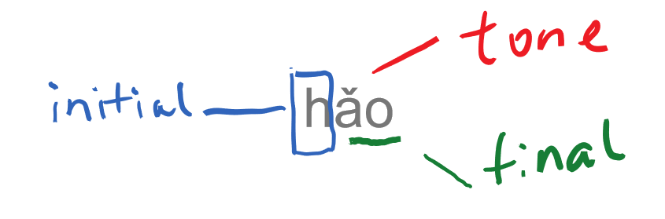
Structure of Pinyin
Pinyin is used to record the sounds of Mandarin. The basic unit of Mandarin pronunciation is called “syllable (yīnjié，音节)”. Usually one Mandarin syllable is spelled with one initial followed by one final, and a tone, except for the special syllable –er.

Slide 6
Initials (21):
b p m f
d t n l
g k h
j q x
z c s
zh ch sh r

Slide 7
Initials: b p m f d t n l
B Like the p in ‘spy’ or ‘spa’; voiceless
P Like the p in ‘pie’ but with a stronger puff of breathe; aspirated
M Like the m in ‘my’
F Like the f in ‘flight’
D Like the t in ‘steam’; voiceless
T Like the t in ‘tea’ but with a strong puff of breathe; aspirated
N Like the n in ‘neat’; move the tip of the tongue slightly more forward
L Like the l in ‘leaf’ but tenser; move the tip of the tongue slightly more forward
Voiced vs Unvoiced Sounds
A voiced sound is one in which the vocal cords vibrate, and an unvoiced sound is one in which they do not.
[s] is an unvoiced sound.
[z] is a voiced sound.
Aspirated Sounds
An aspirated sound is pronounced with an accompanying forceful expulsion of air

Slide 8

Exercise:
ba | pa | ma | fa | da | ta | na | la
bu | pu | mu | fu | du | tu | nu | lu
ban | pan | man | fan | dan | tan | nan | lan
bang | pang | mang | fang | dang | tang | nang | lang
ben | pen | men | fen | den | ten | nen
beng | peng | meng | feng | deng | teng | neng | leng

Slide 9
Initials: g k h
G Like the k in ‘sky; voiceless
K Like the k in ‘kite’ but with a stronger puff of breath; aspirated
H Like the h in ‘hand’ but sounds rougher; fricative
Fricative sounds, such as English f or v, are produced by bringing the mouth into position to block the passage of the airstream, but not making complete closure, so that air moving through the mouth generates audible friction.

Slide 10
Exercise:
ga | ka | ha
ge | ke | he
gu | ku | hu
gao | kao | hao
gei | kei | hei
gua | kua | hua

Slide 11
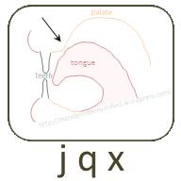
Initials: j q x
J Like the j in ‘jeep’ with the middle part of the tongue pressed tightly against the roof the mouth; fricative
Q Like the ch in ‘cheap’ with a stronger puff of breath and with the middle part of the tongue pressed tightly against the roof of the mouth; fricative
X Between the s in ‘see’ and the sh in ‘she’ with the middle part of the tongue pressed tightly against the roof of the mouth; fricative

Slide 12
Exercise:
ji | qi | xi
jia | qia | xia
jian | qian | xian
jiang | qiang | xiang
jiao | qiao | xiao
jin | qin | xin
jing | qing | xing

Slide 13
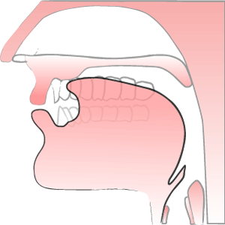
Initials: zh ch sh r
Zh Like the j in ‘jerk’ but stronger, unvoiced and with the tongue curled further back
Ch Like the ch in ‘chirp’, voiced and with the tongue curled further back
Sh Like the sh in ‘shrew’ with the tongue curled further back.
R Like the r in ‘shrew’ with the tongue tip curried a little further back; fricative

Slide 14
Exercise:
zhi | chi | shi | ri
zha | cha | sha
zhan | chan | shan | ran
zhang | chang | shang | rang
zhao | chao | shao | rao
zhong | chong |  | rong

Slide 15
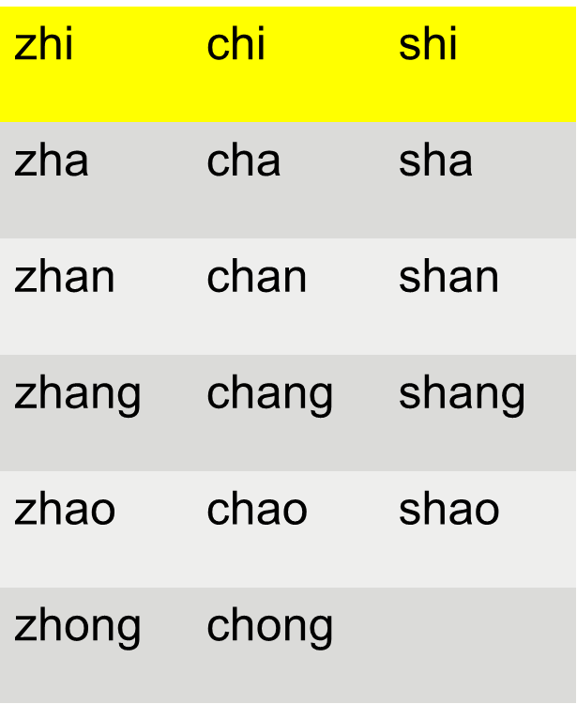
Exercise:
ji | qi | xi
jia | qia | xia
jian | qian | xian
jiang | qiang | xiang
jiao | qiao | xiao
jiong | qiong | xiong

Slide 16
Exercise:
ji | zhi |  | qi | chi |  | xi | shi
jia | zha |  | qia | cha |  | xia | sha
jian | zhan |  | qian | chan |  | xian | shan
jiang | zhang |  | qiang | chang |  | xiang | shang
jiao | zhao |  | qiao | chao |  | xiao | shao
jiong | zhong |  | qiong | chong |  | xiong

Slide 17
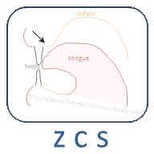
Initials: z c s
Z Like the ds in ‘beds’ but stronger and unvoiced; move tongue tip slightly more forward
C Like the ts in ‘cats’ with a strong puff of breath immediately following; move tongue tip slightly more forward
S Like the s in ‘sign’ but more hissing; move the tongue tip slightly more forward.

Slide 18
Exercise:
zi | ci | si
za | ca | sa
ze | ce | se
zu | cu | su
zai | cai | sai
zao | cao | sao
zuo | cuo | suo

Slide 19
Finals (36)
Basic Finals | a o e i u ü
Compound Finals | ai ei ao ou an en ang eng ong
 | ia iao ie iu(iou) ian in iang ing iong
 | ua uo uai ui(uei) uan un(uen) uang ueng
 | üe üan ün(üen)
 | er

Slide 20
Finals: a o e i u ü
A Like the a in ‘spa’ with the lower jar well down
O After b/p/m, it stands for the final ‘uo’ ; it is pronounced between the woe of ‘woe’ and the wa of the ‘war’
E Like the ir in British English ‘bird’; the back of the tongue is held high; should come from deep down in your throat
Exception：e of ‘ye’ , like the e in ‘yet’ but hold longer.
I Like the ee in ‘see’; the tongue remains steady
Exception: i of zhi/chi/shi/ri/zi/ci/si, has no sound; a place holder
U Like the oo in ‘ooze’ but with the lips rounded; the entire tongue is higher and further back; the tongue remains steady
Exception: u after j/q/x/y stands for the final ‘ü’
ü Made by rounding the lips while saying ee in “see’

Slide 21
Exercise:
a | o | e | i | u | ü
ba | bo |  | bi | bu
ma | mo |  | mi | mu
ga |  | ge |  | gu
la |  | le | li | lu | lü
na |  | ne | ni | nu | nü

Slide 22
Finals: ai ei ao ou an en ang eng ong
AI Like the y in ‘my’ but shorter; pronounce alphabet I and E rapidly
EI Like the ei in ‘sleigh’ but shorter; pronounce alphabet A and E rapidly
AO Between the ow in ‘cow’ and the aw in ‘caw’
OU Like the o in ‘go’ but shorter
AN Like awn in ‘pawn’ but shorter
Exception: YAN sounds like ‘Yen’
EN Like the en in ‘chicken’
ANG Between the ong in ‘song’ and the ung in ‘sung’; no g-sound
ENG Like ung in ‘lung’; no g-sound
ONG Like ong in ‘thong’

Slide 23
Exercise:
ai | ei | ao | ou | an | en | ang | eng | ong
bai | bei | bao | bou | ban | ben | bang | beng
lai | lei | lao | lou | lan |  | lang | leng | long
hai | hei | hao | hou | han | hen | hang | heng | hong
zhai | zhei | zhao | zhou | zhan | zhen | zhang | zheng | zhong
chai |  | chao | chou | chan | chen | chang | cheng | chong

Slide 24
Finals: ia iao ie iu(iou) ian in iang ing iong
IA Like the ya in ‘yacht’ but tenser
IAO Like the yow in ‘yowl’ but shorter
IE Like the ye in ‘yet’ but held longer
IU/IOU Like ‘you’
IAN Like ‘Yen’
IN Like ‘inn’
IANG Like ‘young’; the ng-sound should be less nasal.
ING Like ing in ‘sing; the ng-sound should be less nasal.
IONG (phonics)

Slide 25
Exercise:
ia | iao | ie | iu | ian | in | iang | ing | iong
lia | liao | lie | liu | lian | lin | liang | ling
jia | jiao | jie | jiu | jian | jin | jiang | jing | jiong
qia | qiao | qie | qiu | qian | qin | qiang | qing | qiong
xia | xiao | xie | xiu | xian | xin | xiang | xing | xiong

Slide 26
Finals: ua uo uai ui(uei) uan un(uen) uang ueng
UA Like the wa in ‘wash’ with the mouth open widerly
UO Begin with u, move to o, then end with e; pronounce u-o-e rapidly
Attention： o in ‘bo/po/mo/fo’ stands for ‘uo’
UAI Like the wy in ‘Wyoming’ but shorter
UI(UEI) Like ‘way’ but shorter
UAN Like wan in ‘swan’
Attention: uan in ‘juan/quan/xuan’ stands for ‘üan’, not ‘uan’
UN(UEN) Like wen in ‘went’
UANG Like won in ‘wonky’
UENG (phonics)

Slide 27
Exercise:
ua | uo | uai | ui | uan | un | uang | ueng
zhua | zhuo | zhuai | zhui | zhuan | zhun | zhuang
chua | chuo | chuai | chui | chuan | chun | chuang
shua | shuo | shuai | shui | shuan | shun | shuang
rua | ruo |  | rui | ruan | run

Slide 28
Finals: üe üan ün(üen) and er
ÜE Ü followed immediately by e as in ‘met’
ÜAN Ü followed immediately by an as in ‘pawn’
ÜN(ÜEN) Ü followed immediately by en as in ‘chicken’
and
ER between ‘are’ and ‘err’ with the tongue curled even further back

Slide 29
Exercise:
üe | üan | ün
jue | juan | jun
que | quan | qun
xue | xuan | xun

Slide 30
Tones
Tones in Chinese refer to the pitch patterns which accompany the pronunciation of the whole syllables. The tone is combined with the initial and the final to generate a Chinese syllable. The syllables with exactly the same initials and finals likely have different meanings if the tones are different.
Tone marks are written over the main vowels of a syllable. The main vowels can be identified according the sequence: a-o-e-i-u-ü.

Slide 31
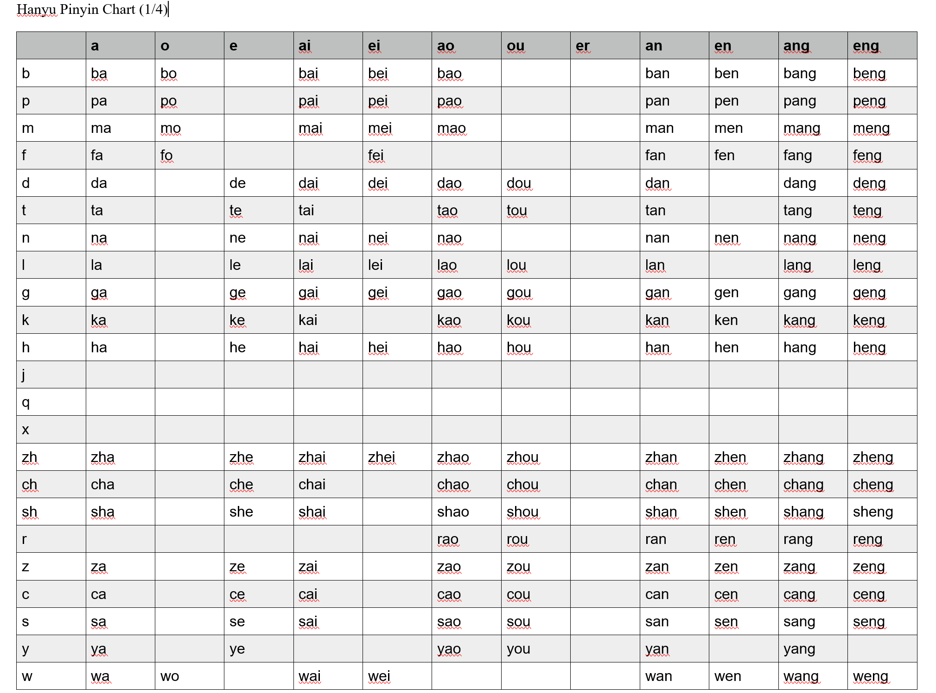
Hanyu Pinyin Chart (1/4)

Slide 32

Hanyu Pinyin Chart (2/4)

Slide 33
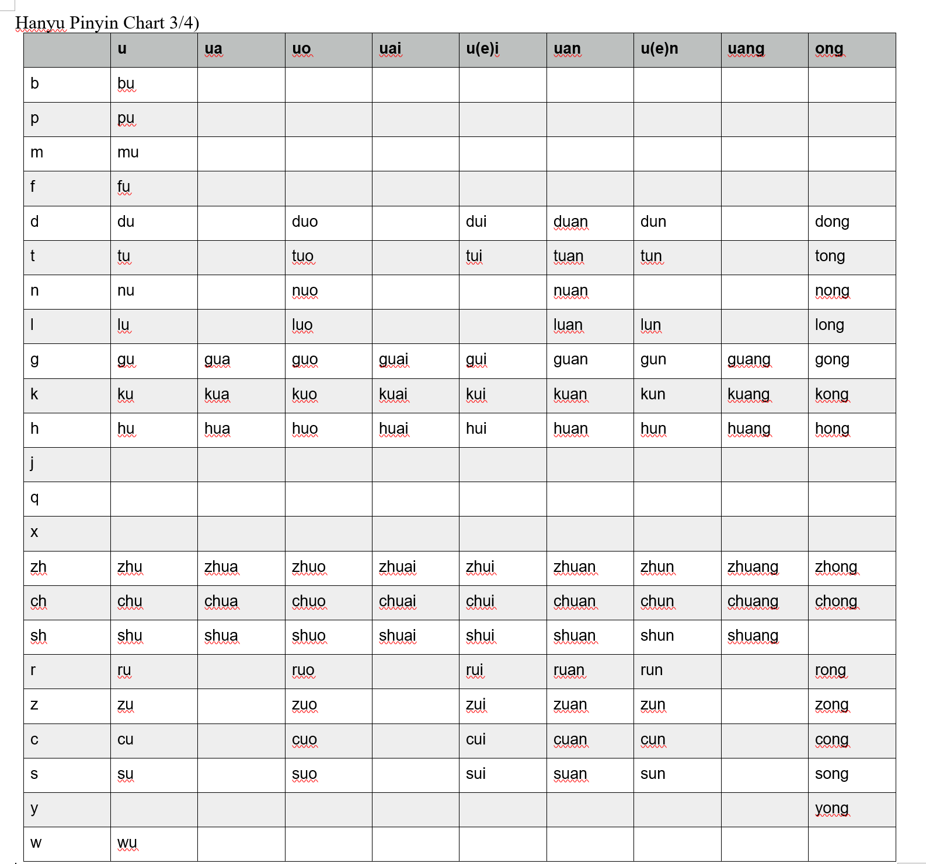
Hanyu Pinyin Chart (3/4)

Slide 34
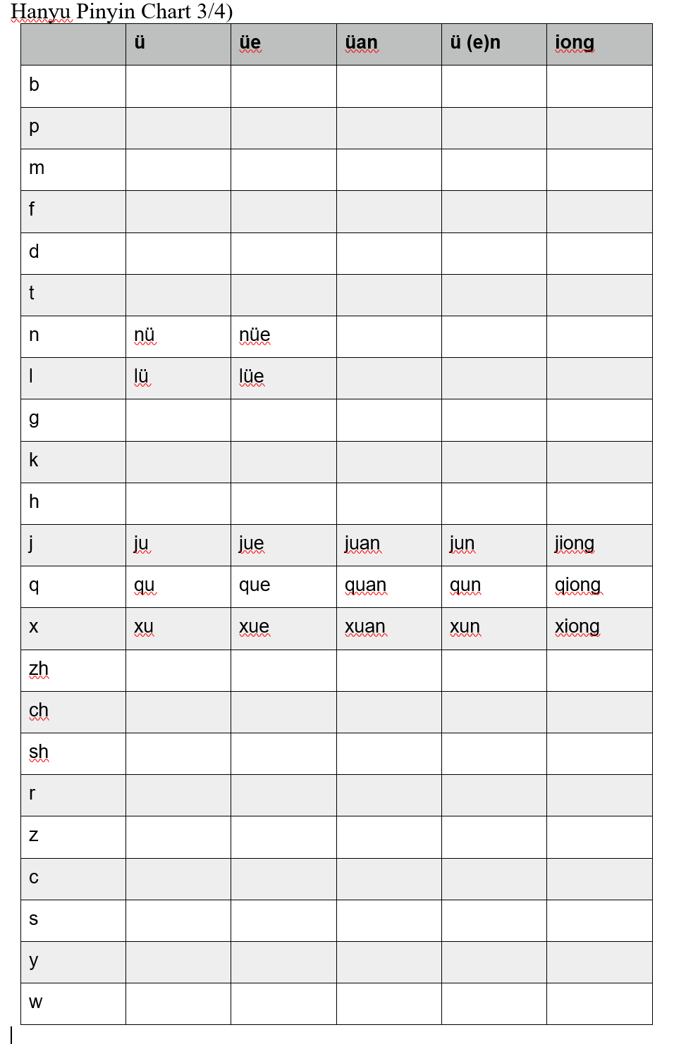
Hanyu Pinyin Chart (4/4)

Slide 35
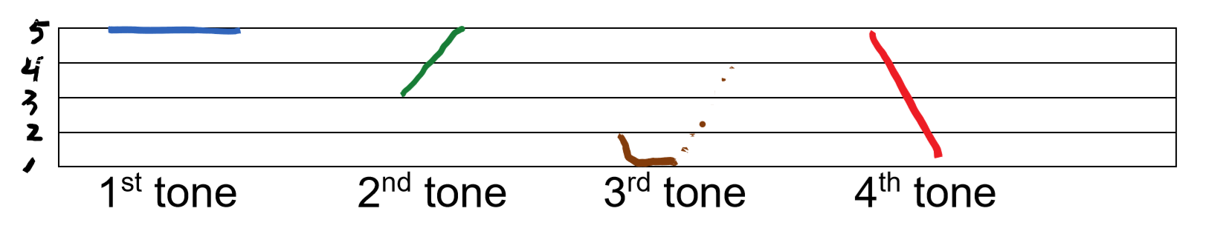
Tones
The first tone is a high-level tone with a pitch value of "5-5" ;
The second tone is a mid-rising tone with a pitch value of "3-5";
The third tone is a low-curve tone with a pitch value of "2-1-1-4 "; and The fourth tone is a high-falling tone with a pitch value of "5-1".

Slide 36
Useful Classroom Expressions
Let's begin the class. | Shàngkè.
Hello, teacher. | Lǎoshī hǎo.
Hello everyone. | Dàjiā hǎo.
Please sit down. | Qǐng zuò.
Repeat after me. | Gēn wǒ shuō.
Say it again. | Zàishuō yībiàn.
Very good. | Hěn hǎo.
The class is over. | Xiàkè.
Thank you, teacher. | Xièxiè lǎoshī.
Goodbye! | Zàijiàn.

